Slide 1
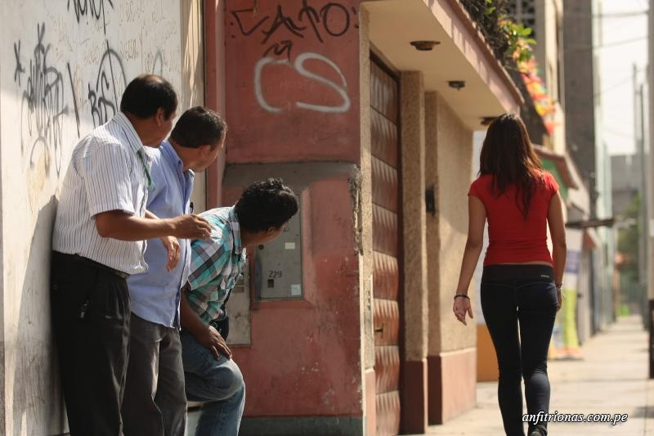

Algorithm to generate
safe routes in Medellín

Slide 2


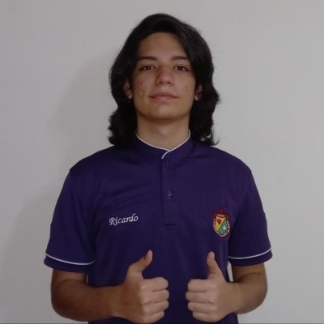



Presentation of the team
Ricardo Gandica
Coding and planning
Sara Quintero
Project analysis
Andrea Serna
Literature review
Mauricio Toro
Data preparation
https://github.com/GatosLoco1990/sexual_harassment_project

Slide 3

Problem Statement
GanQui
Streets
of Medellín, Origin and Destination
Three paths that reduce both the risk of harassment and distance

Slide 4
Solution Algorithm
GanQui
Streets
of Medellín, Origin and Destination
A path that reduces both distance and harassment

Slide 5
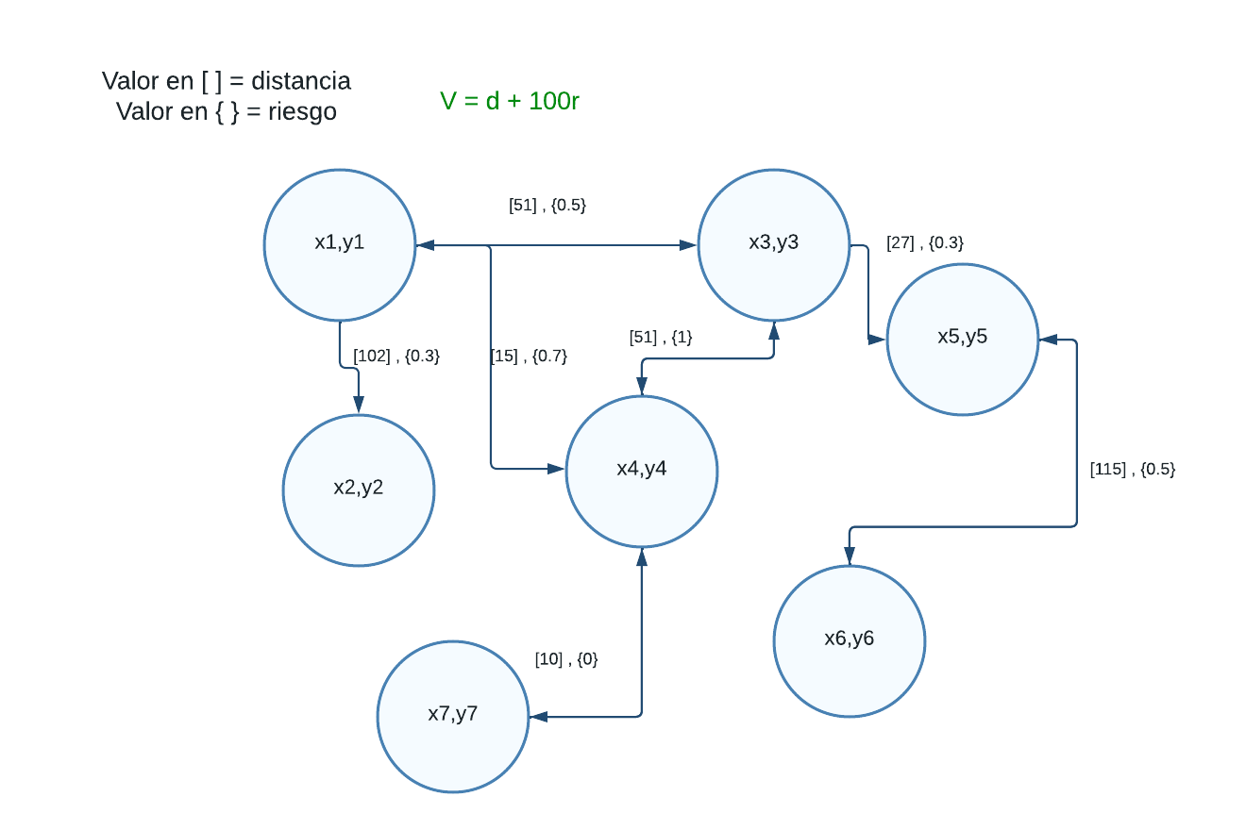

Explanation of the algorithm
GanQui: it’s made upon A*, using as values for cost: distance and the risk and V = d +r // V = d * r // V = d^(2r)

Slide 6

Complexity of the algorithm
 | Time complexity | Complexity of memory
Algorithm name | O(V² *E*2^{V} ) | O(E!*V*E*E*2E )
Algorithm name (if you have tried two) | O(V*V*E*E*E) | O(E!)
Create the table in Powerpoint. Do not copy pixelated screenshots of the white paper, please.
Time and memory complexity of the algorithm name. V is...E is... (In this semester, it could be DFS, BFS, Dijkstra, A*). Please explain what V and E mean in this problem. PLEASE, it is not helpful to put 'n'.
Explain the tables in your
own words
Use superscripts to represent exponents. Do NOT use the ^ symbol.

Slide 7
First path minimizing d = d * h
Origin | Destination | Distance (meters) | Risk of harassment (between 0 and 1)
(6.2815681,-75.5475082) Cl. 89 #38 04, Las Granjas, Medellín, Manrique, Medellín, Antioquia | (6.204122,-75.5836638) Cl. 4 Sur #50ff-2 a 50ff-44, Guayabal, Medellín, Guayabal, Medellín, Antioquia | 12071.823000000006 m | 126.19469958171223
Distance and risk of harassment for the path that minimizes d = ??. Execution time of ?? seconds.

Slide 8
Second path minimizing d = d + h
Origin | Destination | Distance (meters) | Risk of harassment (between 0 and 1)
(6.2815681,-75.5475082) Cl. 89 #38 04, Las Granjas, Medellín, Manrique, Medellín, Antioquia | (6.204122,-75.5836638) Cl. 4 Sur #50ff-2 a 50ff-44, Guayabal, Medellín, Guayabal, Medellín, Antioquia | 11031.772000000003m | 109.354230569381
Distance and risk of harassment for the path that minimizes d = ??. Execution time of ?? seconds.

Slide 9
Third path minimizing d = d ^2(h)
Origin | Destination | Distance (meters) | Risk of harassment (between 0 and 1)
(6.2815681,-75.5475082) Cl. 89 #38 04, Las Granjas, Medellín, Manrique, Medellín, Antioquia | (6.204122,-75.5836638) Cl. 4 Sur #50ff-2 a 50ff-44, Guayabal, Medellín, Guayabal, Medellín, Antioquia | 12585.883000000003 m | 113.8612825179079
Distance and risk of harassment for the path that minimizes d = ??. Execution time of ?? seconds.
The font size must be at least 22 points.

Slide 10
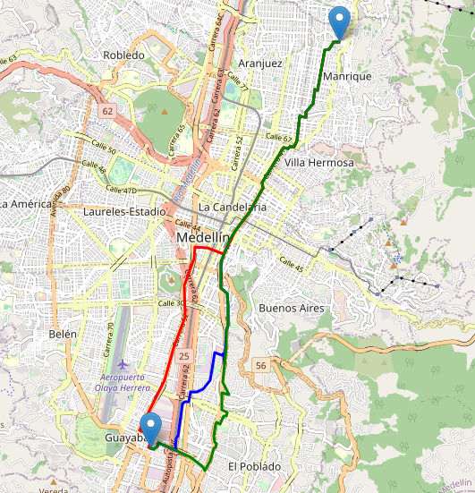
Visual comparison of the three paths

Slide 11

Future work directions
Probability
Optimization 1
Statistics 2
M & S 4
MV risk estimates
Investigate more zones, and include other parameters than the sensation of safety
Traffic Estimation
What kind of neighbor is it?, it is common that people walk a lot around that zone?
Other risk estimates
The probability of robbery.
The probability of been killed.
Optimization Bi target
minimize costs.
minimize raw material in the development of a good

Slide 12

!!
THANK YOU!!!
With the support of
Ricardo Gandica was supported by the e generation scholarship, the second author Sara Quintero last two authors were supported by the Sapiencia grant, financed by the municipality of Medellín. All authors are grateful to the Vice Rector's Office for Discovery and Creation, Universidad EAFIT, for their support in this research.

